Slide 1
Scene Creation and Management

Slide 2
Learning Objectives
Understand the concept of scenes in Unity.
Learn how to create and organize scenes effectively.
Grasp scene management techniques for complex projects.

Slide 3

What are Scenes in Unity?
Scenes are where you work with content in Unity.
They are assets that contain all or part of a game or application. ^{[8]}
A scene is the term Unity uses to describe what you might already know as a level. As you develop a Unity project, each collection of objects and behaviors should be its own scene. Therefore, if you were building a game with a snow level and a jungle level, those would be separate scenes.^{[3]}
Although it is certainly possible to build large and complex games in this way, it is generally much easier to use multiple scenes. The idea behind a scene is that it is a self-contained collection of game objects.^{[3]}
5: Thorn, Alan, Pro Unity game development with C#, 2014
8: Unity Technologies, Unity Manual, 2023
Notes:
• Definition of scenes as individual levels, environments, or segments of a game.
• Explanation of how scenes contribute to the overall structure and flow of a game project.

Slide 4
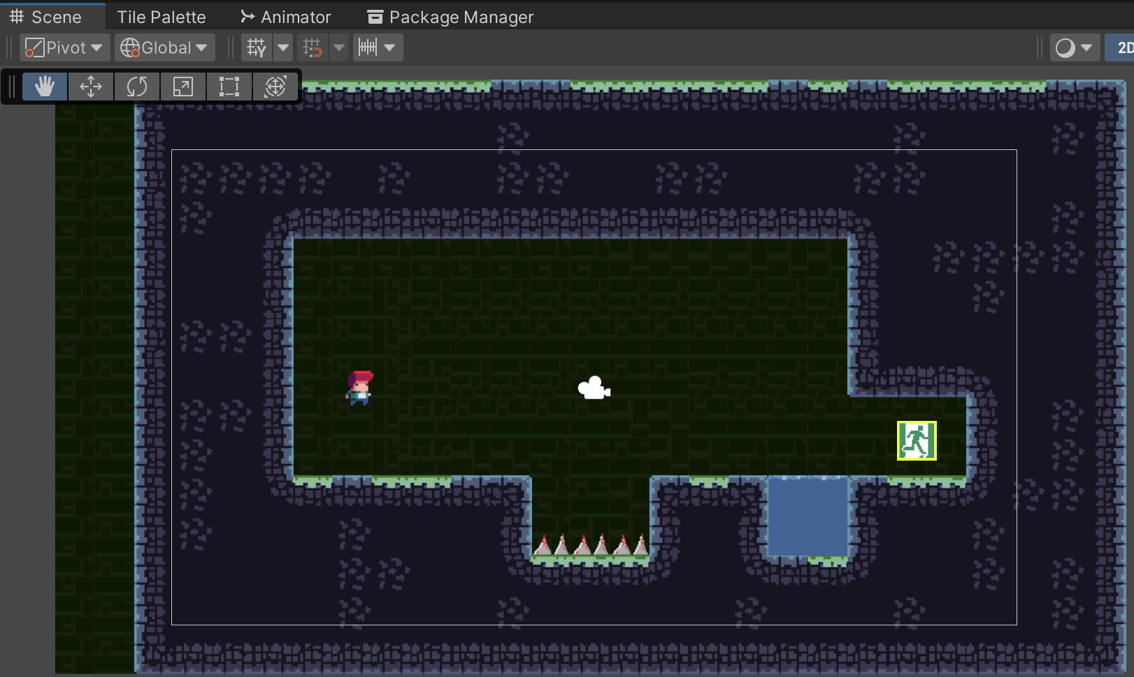
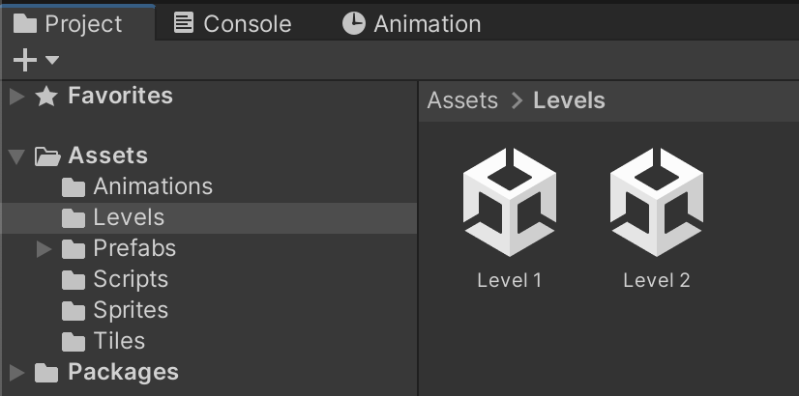
Scene Creation Basics
Open Unity and click on "File."
Select "New Scene" to create a new environment.
Name your scene and save it in your preferred location.
Double click on scene icon on project window to open a scene
Notes:
Tip: rename scene “You can rename the scenes inside the Project/Assets/Scenes folder, on project tab”

Slide 5
Scene – Interface Overview
Essential Interface Elements
Scene View: Provides a visual representation of the scene. Here, you can position, rotate, and scale objects.
Hierarchy Panel: Lists all GameObjects in the scene, allowing you to organize and manage them hierarchically.
Inspector Window: Displays properties of selected GameObjects, enabling modification of their attributes.
Toolbar: Houses tools for navigating and manipulating the Scene view, including Move, Rotate, and Scale.

Slide 6
Working with Scenes
Key Points
Scene creation involves organizing and arranging GameObjects.
The Scene view enables visual editing, while the Hierarchy panel offers a structured view of GameObjects.
Understanding interface elements is crucial for efficient scene manipulation and design.

Slide 7
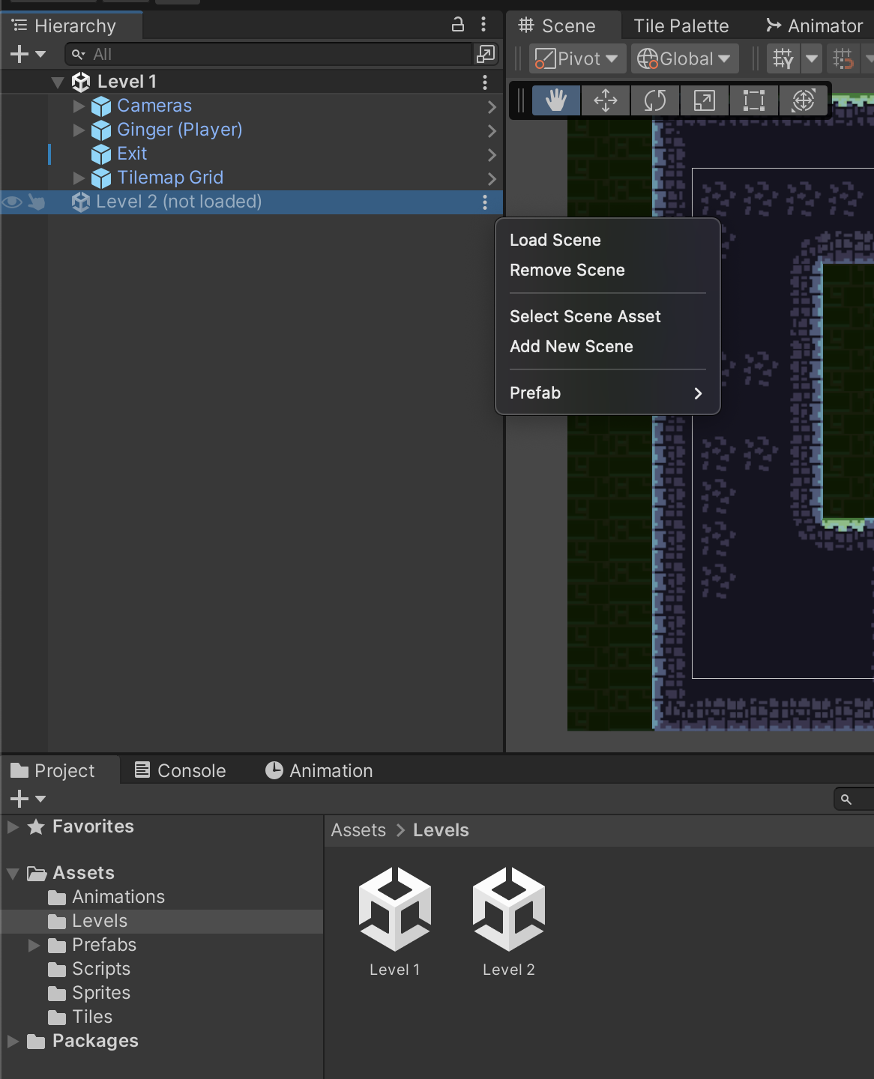
Navigating Between Scenes
UnityEngine.SceneManagement provides functionalities for managing scenes, including switching between them, adding/removing scenes, and controlling their states
Loading Scenes: Use SceneManager.LoadScene() to load a new scene, either by scene name or by index in the build settings.
Unloading Scenes: Use SceneManager.UnloadScene() to remove unnecessary scenes when they're no longer needed.
Scene Switching: Use SceneManager.LoadScene() to switch from the current scene to another.

Slide 8
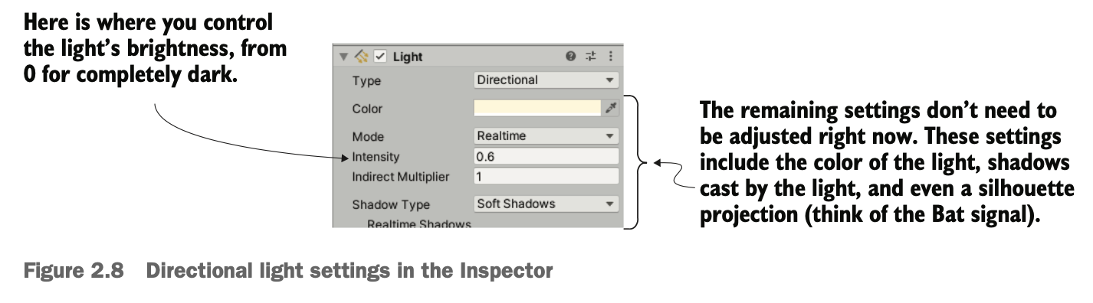
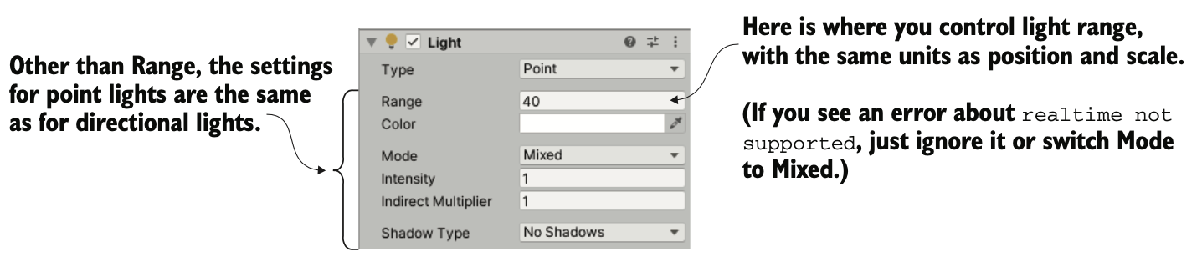
Scene Lighting and Camera Setup
Types of lights: You can create several types of light sources, defined by how and where they project light rays. The three main types are point, spot, and directional.
1: Hocking, Joseph; Schell, Jesse, Unity in action: multiplatform game development in C#, 2022

Slide 9
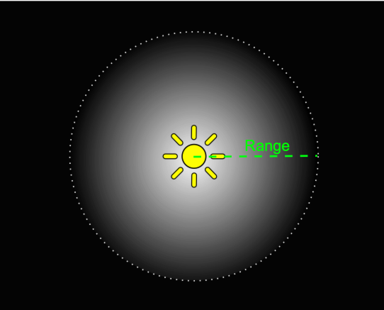
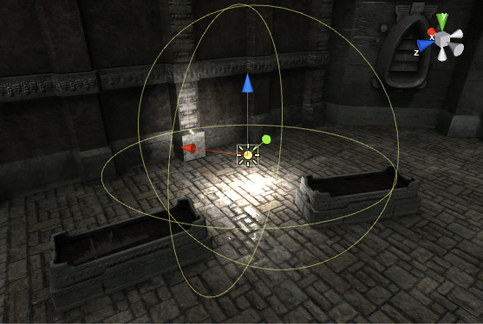
Scene Lighting and Camera Setup
In point lights, all the light rays originate from a single point and project out in all directions, like a light bulb in the real world. The light is brighter up close because the light rays are bunched up.
Point lights are useful for simulating lamps and other local sources of light in a scene. You can also use them to make a spark or explosion illuminate its surroundings in a convincing way.
8: Unity Technologies, Unity Manual, 2023

Slide 10
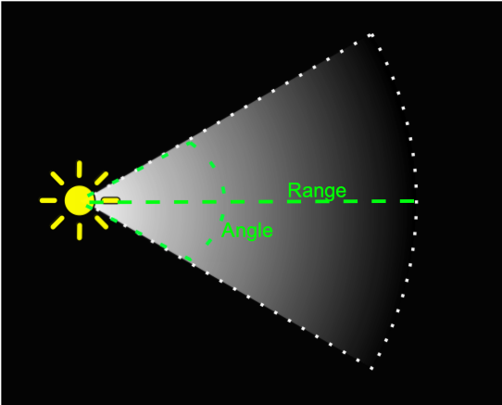
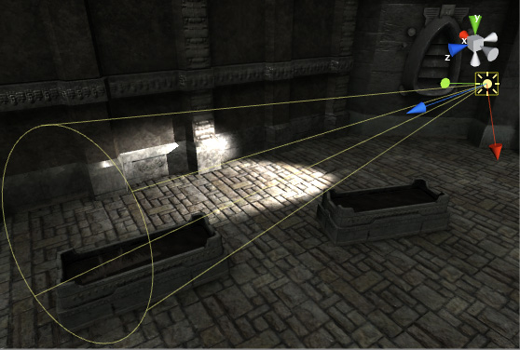
Scene Lighting and Camera Setup
In spot lights, all the light rays originate from a single point but project out in only a limited cone. No spot lights are used in the current project, but these lights are com- monly used to highlight parts of a level.
8: Unity Technologies, Unity Manual, 2023

Slide 11
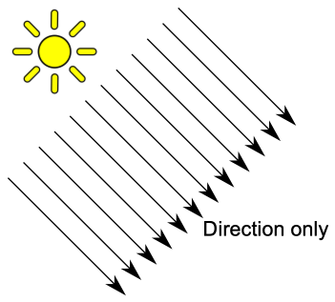
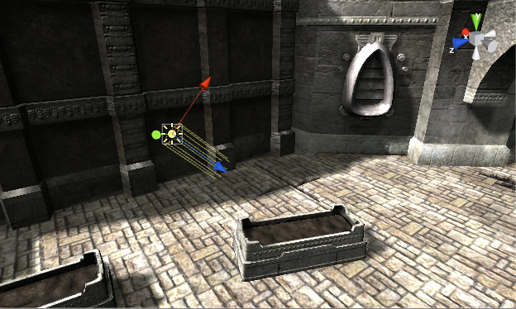
Scene Lighting and Camera Setup
In directional lights, all the light rays are parallel and project evenly, lighting everything in the scene the same way. This is like the sun in the real world
8: Unity Technologies, Unity Manual, 2023

Slide 12
Scene Saving and Loading
Scene saving and loading in Unity involves preserving the state of a scene so that it can be restored or reloaded at a later time. This process is crucial for games where players need to save their progress or return to specific points within the game.
Notes:
Data Collection:
Identify and gather relevant data that needs to be saved, such as:
Positions, rotations, and states of game objects.
Player inventory, progress, or game settings.
Any other critical information related to the scene's state.
Serialization:
Convert this gathered data into a serializable format (JSON, XML, binary, etc.) using Unity's serialization techniques or custom serialization methods.
Unity's built-in serialization system (e.g., JsonUtility, BinaryFormatter) or custom serialization scripts can be used here.
Storage Management:
Save the serialized data to a storage medium (local files, player prefs, databases, etc.) to persist across game sessions.
Choose an appropriate storage method based on the complexity of the data and the required security or accessibility.
Loading Process:
Retrieve the saved data from storage when needed, such as when a player wants to resume a saved game or reload a specific scene state.
Deserialize the data to convert it back into usable game information.
Scene Reconstruction:
Use the deserialized data to reconstruct the scene's previous state, setting object positions, restoring player progress, and applying any other saved information.
Implementation in Unity:
Unity offers PlayerPrefs for simple data storage, and developers can also create custom scripts to manage more complex data saving/loading.
ScriptableObjects, PlayerPrefs, or external files are commonly used to save game settings, player progress, or scene states.

Slide 13
Scene Saving and Loading
Data Collection: Identify and gather relevant data that needs to be saved
Serialization: Convert this gathered data into a serializable format (JSON, XML, binary, etc.) using Unity's serialization techniques or custom serialization methods.
Storage Management: Save the serialized data to a storage medium to persist across game sessions.
Loading Process: Retrieve the saved data from storage when needed, such as when a player wants to resume a saved game or reload a specific scene state

Slide 14
Scene Saving and Loading
Scene Reconstruction: Use the deserialized data to reconstruct the scene's previous state, setting object positions, restoring player progress, and applying any other saved information.
Implementation in Unity: Unity offers PlayerPrefs for simple data storage, and developers can also create custom scripts to manage more complex data saving/loading.
ScriptableObjects, PlayerPrefs, or external files are commonly used to save game settings, player progress, or scene states.

Slide 15
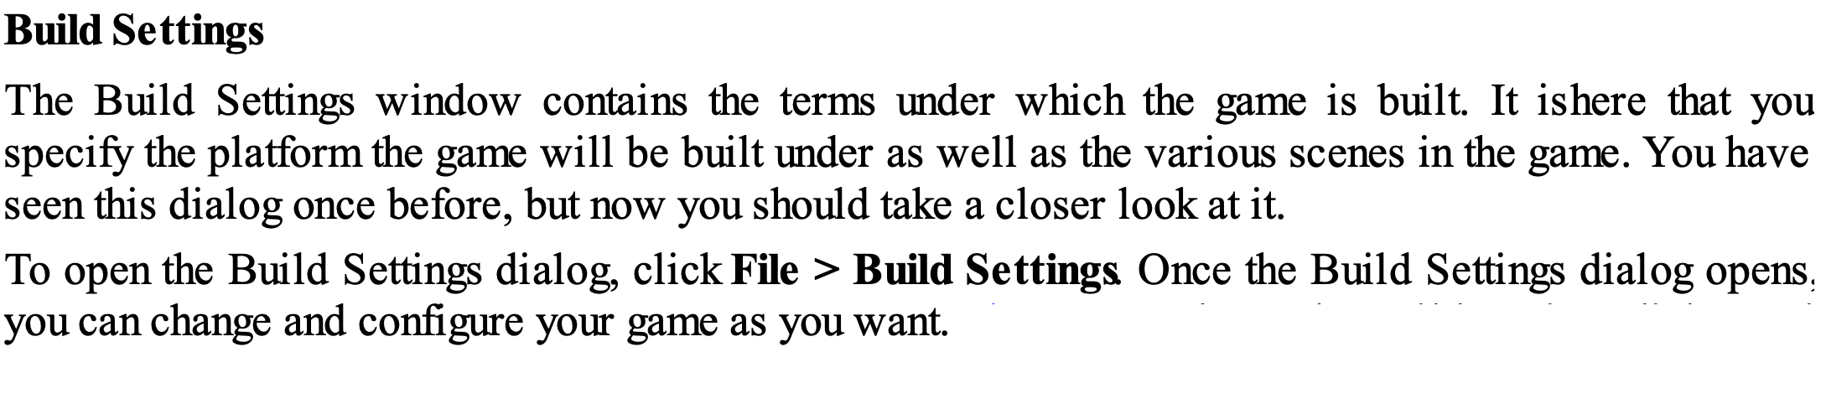
Build Settings and Player Configuration
3: Geig, Mike, Sams teach yourself Unity Game development in 24 hours, 2014

Slide 16
Build Settings
Adding scenes to Build Settings in Unity is a crucial step when preparing to build your game. This process determines which scenes you've created in the Editor will be included when you publish your game.
Add Scenes
Drag and drop scenes from the Project Window into the "Scenes In Build" section or click on "Add Open Scenes" to automatically add scenes that are currently open in the Editor.
The scene at the top of the list will be the initial scene loaded upon starting the game.
Adding scenes to Build Settings not only determines the game's startup sequence but is also a crucial step in defining the necessary content for the final build, optimizing performance, and enhancing the overall player experience.

Slide 17
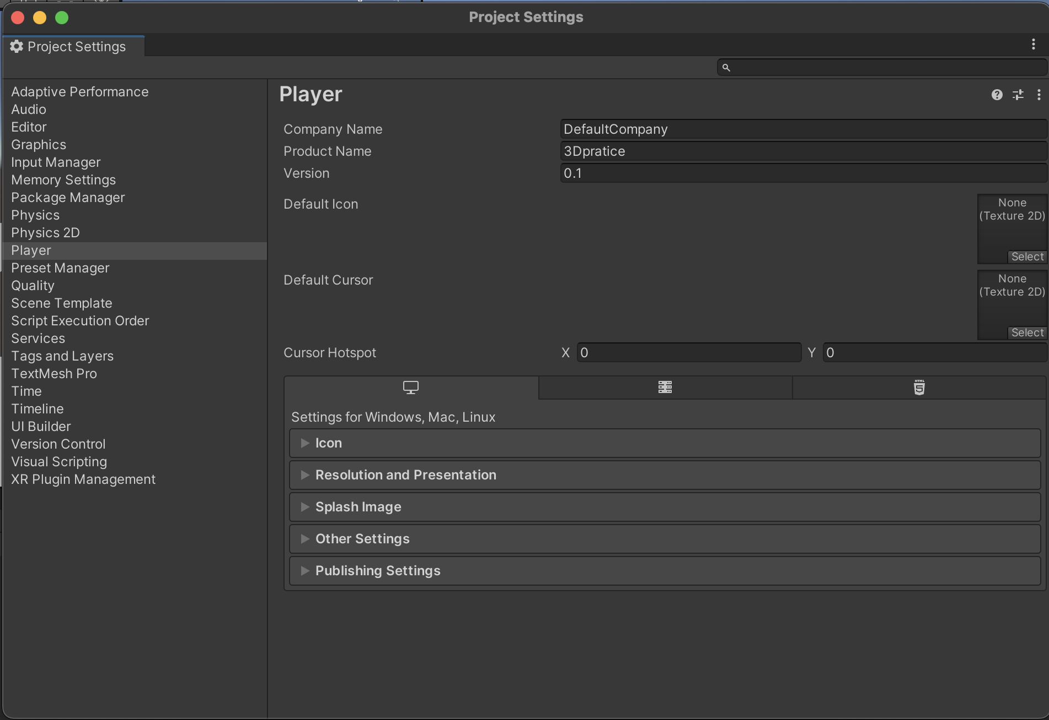
Player Configuration
In Unity, when exporting a build you are effectively placing your content into what is known as the Unity player. As a standalone build, the player is part of the packaged executable PC or Mac game.
10: Goldstone Will, Unity 3.x game development essentials, 2011

Slide 18
Player Configuration
In Player Settings, you can specify certain elements, such as resolution, icons and rendering settings, for the player to use.
The Player Settings in Unity are divided into two core separations—Cross-Platform Settings and Per Platform Settings.

Slide 19
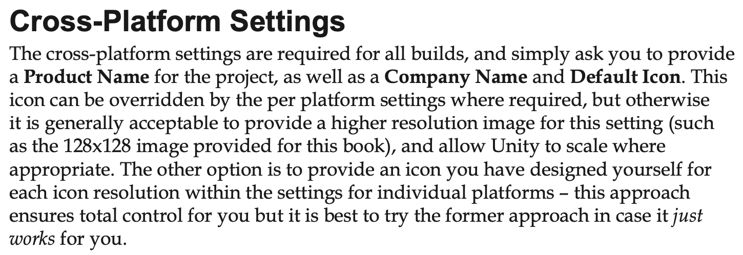
Player Configuration
10: Goldstone Will, Unity 3.x game development essentials, 2011

Slide 20
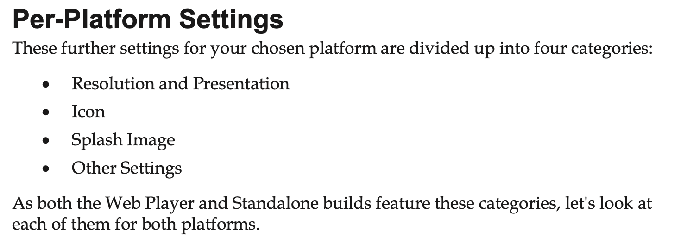
Player Configuration

Slide 21
Practical Exercise - Scene Creation
Change name of current scene to _Scene_0
Create new scene for Airplane game, called _Scene_1.
Create Prefab for Airplane GameObject in _Scene_0
Drag and drop Airplane Prefab to new scene and change its name to Player.
Advance practice
Create the level exit trigger, and switch to _Scene_1 when the airplane go through the trigger cube.
Notes:
The exercises for this lesson are aimed at getting students familiar with the operations of working with scenes and prefabs.

Slide 22
Practice 1 – Creating a New Scene
Creating a New Scene
Open Unity and create a new project (if you don’t have one already).
Go to File > New Scene or use the shortcut Ctrl + N (Cmd + N on Mac) to create a new scene.
Notes:
Practice Resources sharing:
https://drive.google.com/drive/folders/1eXu20cX1o-5uMFuSeHGxRS5AkhDZJTOP?usp=sharing

Slide 23
Practice 1 – Understanding the Interface
Familiarize yourself with the Unity interface:
Scene view: Manipulate GameObjects, navigate the scene.
Hierarchy panel: List of GameObjects in the scene.
Game view: Preview how the scene looks in play mode.
Inspector: Details of selected GameObjects.
Toolbar: Access various tools for editing the scene.

Slide 24
Practice 1 – Manipulating GameObjects
In the Hierarchy panel, create a few GameObjects (e.g., cubes, spheres, or sprites) by right-clicking and choosing "Create Empty" or using GameObject > 3D Object.
Explore the Transform tools (Move, Rotate, Scale) in the Scene view toolbar. Select a GameObject and use these tools to manipulate its position, rotation, and scale.
Experiment with different views (2D, 3D) in the Scene view using the controls in the top-right corner.

Slide 25
Practice 1 – Organizing and Saving the Scene
Rename GameObjects in the Hierarchy panel to keep the scene organized.
Save the scene by going to File > Save Scene or use the shortcut Ctrl + S (Cmd + S on Mac). Name the scene appropriately.

Slide 26
Conclusion and Next Steps
Scene Fundamentals: Explored scenes as distinct segments crucial for structuring games, emphasizing their impact on overall project flow.
Practical Techniques: Covered scene creation, navigation, organization strategies, lighting, camera setup, saving/loading scenes, Build Settings, and Player Configuration.
Hands-on Experience: Participants engaged in practical exercises, creating scenes, adding and organizing game objects, enhancing their proficiency in scene management.

Slide 27
References
1: Hocking, Joseph; Schell, Jesse, Unity in action: multiplatform game development in C#, 2022
3: Geig, Mike, Sams teach yourself Unity Game development in 24 hours, 2014
6: Gibson Bond, Jeremy, Introduction to Game Design, Prototyping, and Development: From Concept to Playable Game with Unity and C,
8: Unity Technologies, Unity Manual, 2023
10: Goldstone Will, Unity 3.x game development essentials, 2011

